Slide 1


Global Academy of Technology Department of Information Science & Engineering
Seminar on
Fog Screen
Presented by:
Meghavarshini M -1GA15IS021
Guided by:
Shruthi K R
Asst. Professor
Dept. of ISE
02-05-19
Seminar:15IS86
Dept of ISE,GAT 2018-19

Slide 2
CONTENTS
Abstract
Introduction
Literature survey
Existing system
Proposed methodology
Results
Conclusion
02-05-19
Seminar:15IS86
Dept of ISE,GAT 2018-19

Slide 3
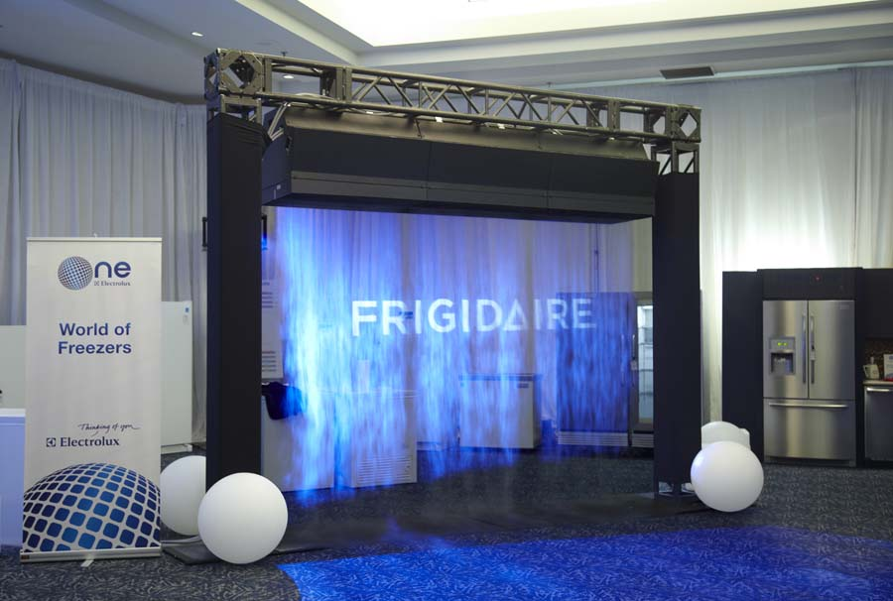
ABSTRACT
Fog Screen is breakthrough technology that allows projection of high quality images in the air. It is currently the only walk-through projection screen. You can literally use the air as your user interface by touching only the air with your bare hands. The screen is created by using a suspended fog generating device with no frame around, and works with video projectors.
02-05-19
Seminar:15IS86
Dept of ISE,GAT 2018-19

Slide 4
INTRODUCTION
Inspired by science fiction movies such as Star Wars, two Finnish virtual reality researchers created the Fog Screen to recreate some of the effects from these movies in real life.
Fog Screen is an exciting new projection technology that allows to project images and video onto a screen of “dry” fog, creating the illusion that the images are floating in mid-air
Fog Screen has been used in live malls, product launches, museums, to attract more and more peoples.
02-05-19
Seminar:15IS86
Dept of ISE,GAT 2018-19

Slide 5
LITERATURE SURVEY
No. | Author | Year | Technique used | Description
1 | Jayshree Khandagale, Deepak Fodse, Poonam Sul, Prita Patil | 2016 | Secure data in cloud using decoy technology | The System mainly uses decoy information and user behavior profiling to secure data on Cloud. The fog computing mechanism facilitates security features to data and thereby allows for detection of invalid access
2 | D.Deepshika J.Deepthi Mrs.V.Aruna | 2017 | Fog Screen technology. | The System enables one to view 3D objects in mid-air and observe them from almost any angle. Using it as an immaterial, head-tracked dual-sided display, has led to an enhanced visualization experience. .
3 | Miu-Ling Lam | 2017 | Novel Volumetric Display using Fog Emitter Matrix | This system constructed the fog screen with a 2D array of nozzles that are individually switchable, while the switching pattern is tightly synchronized with the video content
02-05-19

Slide 6
LITERATURE SURVEY CONT…
No. | Author | Year | Techniques used | Description
4 | Miu-Ling Lam, Bin Chen, Kit-Yung Lam, and Yaozhun Huang | 2014 | 3D Fog Display using Parallel Linear Motion Platforms. | This system suggests a new 3D fog display that exploits spatial projection mapping technique on a non-planar, reconfigurable fog screen to display volumetric data in real 3D space
5 | Prachi Agarwal , Lakshavya Garg , Dr. Vineeta Parihar | 2018 | Fog screen projection | This system suggests that screen can be created by using a suspended fog generating device with no frame around, and works with video projectors
02-05-19
Seminar:15IS86
Dept of ISE,GAT 2018-19

Slide 7
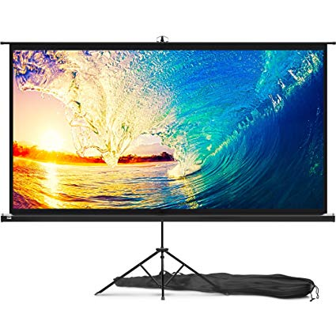
EXISTING SYSTEM
Techniques used :
Some of the existing system are:
Rigid wall mounted screens
Pull down Screens
Electric Screens
Switchable projection screens
02-05-19
Seminar:15IS86
Dept of ISE,GAT 2018-19

Slide 8
DISADVANTAGES OF EXISTING SYSTEM
Projections can be obscured
storage space
Sizing issue and setup
Damage the Screen
Health Dangers
02-05-19
Seminar:15IS86
Dept of ISE,GAT 2018-19

Slide 9
PROPOSED METHODOLOGY
It is one type of advanced projecting device which consumes water and electricity to form fogs on which images are projected.
Fog Screen is a patented technology, which Rakkolainen, one of the senior researchers and founders behind this technology, describes as, ”an immaterial projection screen that consists of air and a little humidity, and enables high-quality projected images in thin-air, as well as many new applications.´.
02-05-19
Seminar:15IS86
Dept of ISE,GAT 2018-19

Slide 10
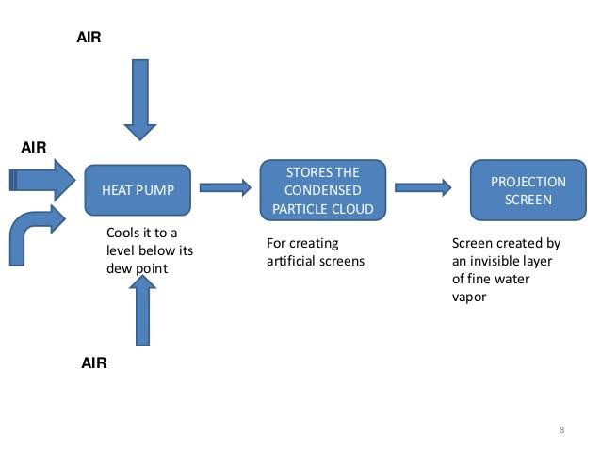
PROPOSED METHODOLOGY
02-05-19
Seminar:15IS86
Dept of ISE,GAT 2018-19

Slide 11
FORMATION OF FOG SCREEN
Fog screen technology is a high-Tech version of the technology in a cool air humidifier.
Tap water is pumped into the fog tank where it is blasted with ultrasound, turning it instantly with thick fog made of tiny water particles 2-3 microns in diameter.
The tank's internal design plus 3 sets of fans work together to create a very thin wall of mist about half of an inch thick.
One set of fans blows the fog downwards while the other two sandwiches the fog between air curtains so that it becomes smooth projection screen.
02-05-19
Seminar:15IS86
Dept of ISE,GAT 2018-19

Slide 12
WORKING OF FOG SCREEN
Fog Screen works much like many screens in terms of its projection properties and requires a 2kw power supply.
A major difference is the need for a water supply, with on screen using fifty liters of tap water per hour.
The Device situated above the fog screen enables the purification of the water via a silver-ion channel and minerals within the tank are cleaned out through regular maintenance.
The opacity will depend on a number of factors, mainly fog density, the projector, image brightness, and the background.
It appears to be a very versatile technology and can be combined with many methods in order to achieve the imagery required, such as pseudo 3Ddisplay and mechanisms to allow further interactivity via tracking.
02-05-19
Seminar:15IS86
Dept of ISE,GAT 2018-19

Slide 13
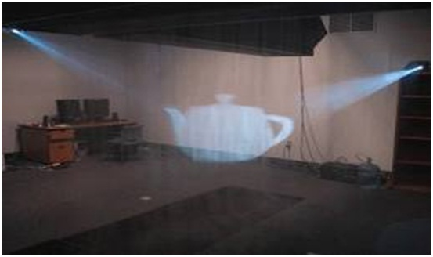
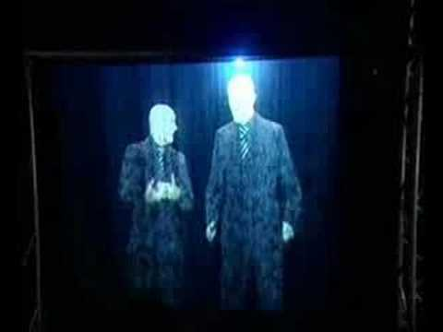
RESULTS
02-05-19
Seminar:15IS86
Dept of ISE,GAT 2018-19

Slide 14
SUCCESS OF FOG SCREEN
Fog Screen has been successfully used in this international event:
Entertainment (live shows, live concerts, nightclubs, stage productions, private parties i.e. Disney Enchanted Tour, Eurovision, Harrah’s, Cirque deSoleil, MGM Grand, 20th Century Fox)
Brand promotions (P&G, Diesel, Victoria’s Secret. Bud light/Maxim Tour, Xbox)
Trade shows and exhibition events (Nokia, Motorola, Sony, Siemens)
Theme parks (Key US theme parks)
Museums and Science Centers
02-05-19
Seminar:15IS86
Dept of ISE,GAT 2018-19

Slide 15
CONCLUSION
Technology of the future literally revolutionizes the limits of projection screens and blurs the boundaries among art, science, and fun.
02-05-19
Seminar:15IS86
Dept of ISE,GAT 2018-19

Slide 16
REFERENCES
[1]Jayshree khandagale1, Deepak fodse2, Poonam sul3, prita patil4 , “ fog computing ”, issn 2321 3361 © 2016 ijesc volume 6 issue no. 3 .
[2]D. Deepshika, J.Deepthi Mrs.V.Aruna,,”fog screen technology” (ijitr) international journal of innovative technology and research volume no.5, issue no.2, february – march 2017,.
[3]Miu-Ling Lam,” A Novel Volumetric Display using Fog Emitter Matrix”, IEEE International Conference on Robotics and Automation (ICRA) 2015.
[4]Miu-Ling Lam*,1,2, Bin Chen1, Kit-Yung Lam1, and Yaozhun Huang3, “3D Fog Display using
[5]Parallel Linear Motion Platforms”. International Conference on Virtual Systems and Multimedia(VSMM), 2014
[6]Prachi Agarwal1 , Lakshavya Garg2 , Dr. Vineeta Parihar3,” Fog screen projection”, National Journal of Multidisciplinary Research and Development, Volume 3; Issue 1; January 2018.
Seminar:15IS86
Dept of ISE,GAT 2018-19

Slide 17
Thank you

